Slide 1
Spectral Phase Retrieval
Updates 14 Oct

Slide 2
State of the art phase retrieval papers
DeepPhaseCut: https://arxiv.org/pdf/2011.10475.pdf, preprint: 20 Nov 2020
Phase Retrieval Using Conditional GAN: paper, code, ICPR - 2020-video, preprint: 8 Jul 2020
Non-Iterative Phase Retrieval With Cascaded Neural Networks, paper, preprint: 18 Jun 2021
Deep Learning Initialized Phase Retrieval, paper, NeurIPS 2020 Workshop on Deep Learning and Inverse Problems, virtual.
Old school algorithms: code

Slide 3
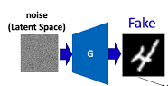
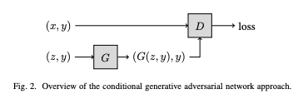
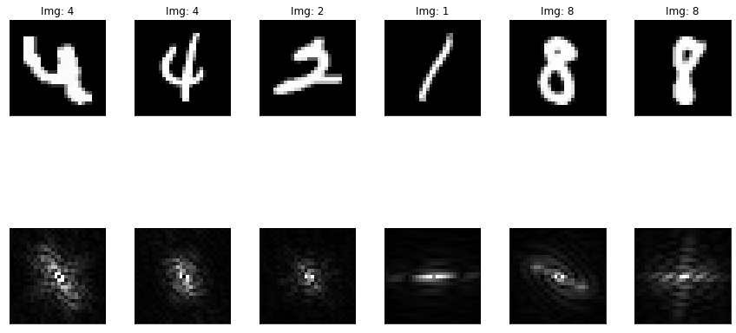



Phase Retrieval Using Conditional GAN: paper, code, ICPR - 2020-video
Y
z
Methods:
Generator produce image from random state z and magnitude Y
Conditional discriminator get Fake generated/Real image and its magnitude
Implemented fitting for each instance
Magnitude Noise assumption
Experiments for toy examples: NIST- datasets and CelebA, CIFAR-10(Fails)

Slide 4
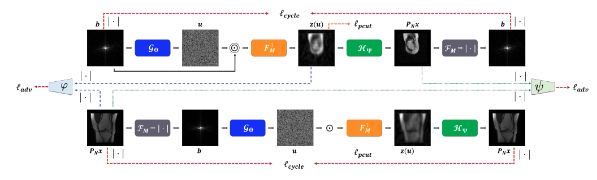
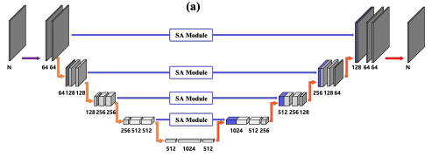
DeepPhaseCut: https://arxiv.org/pdf/2011.10475.pdf
Image Refinement(Unet)
DFT and modulation
Phase Generator(Unet)
Pseudo iDFT
Generators
100% supervised!!!

Slide 5
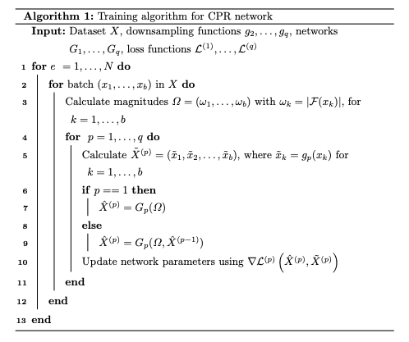
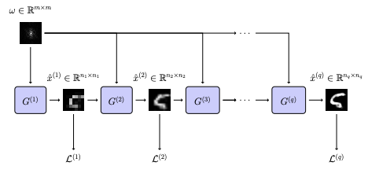
Non-Iterative Phase Retrieval With Cascaded Neural Networks, paper

Slide 6
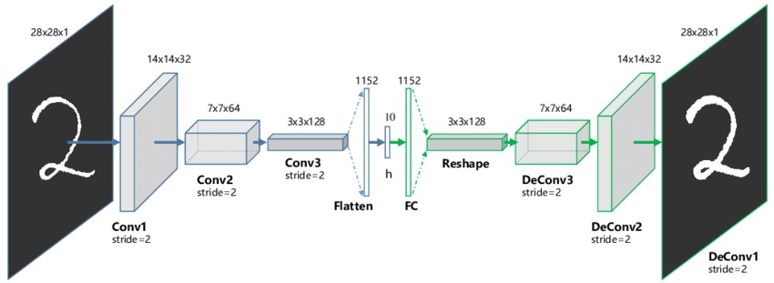


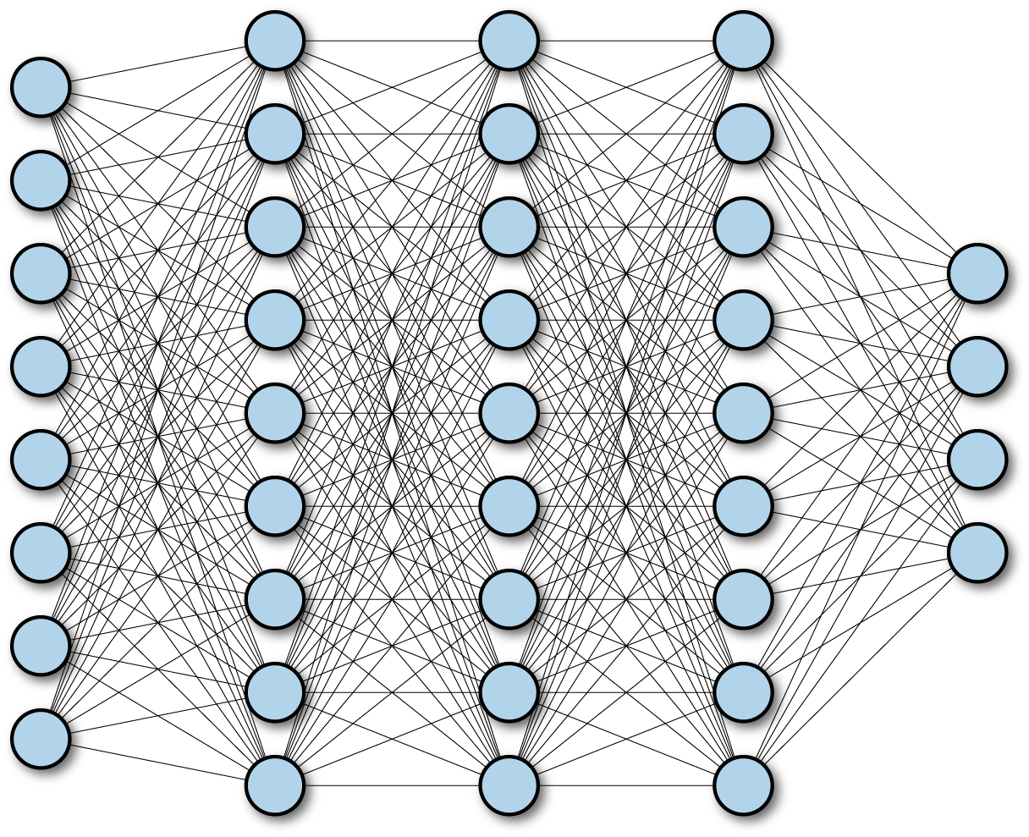

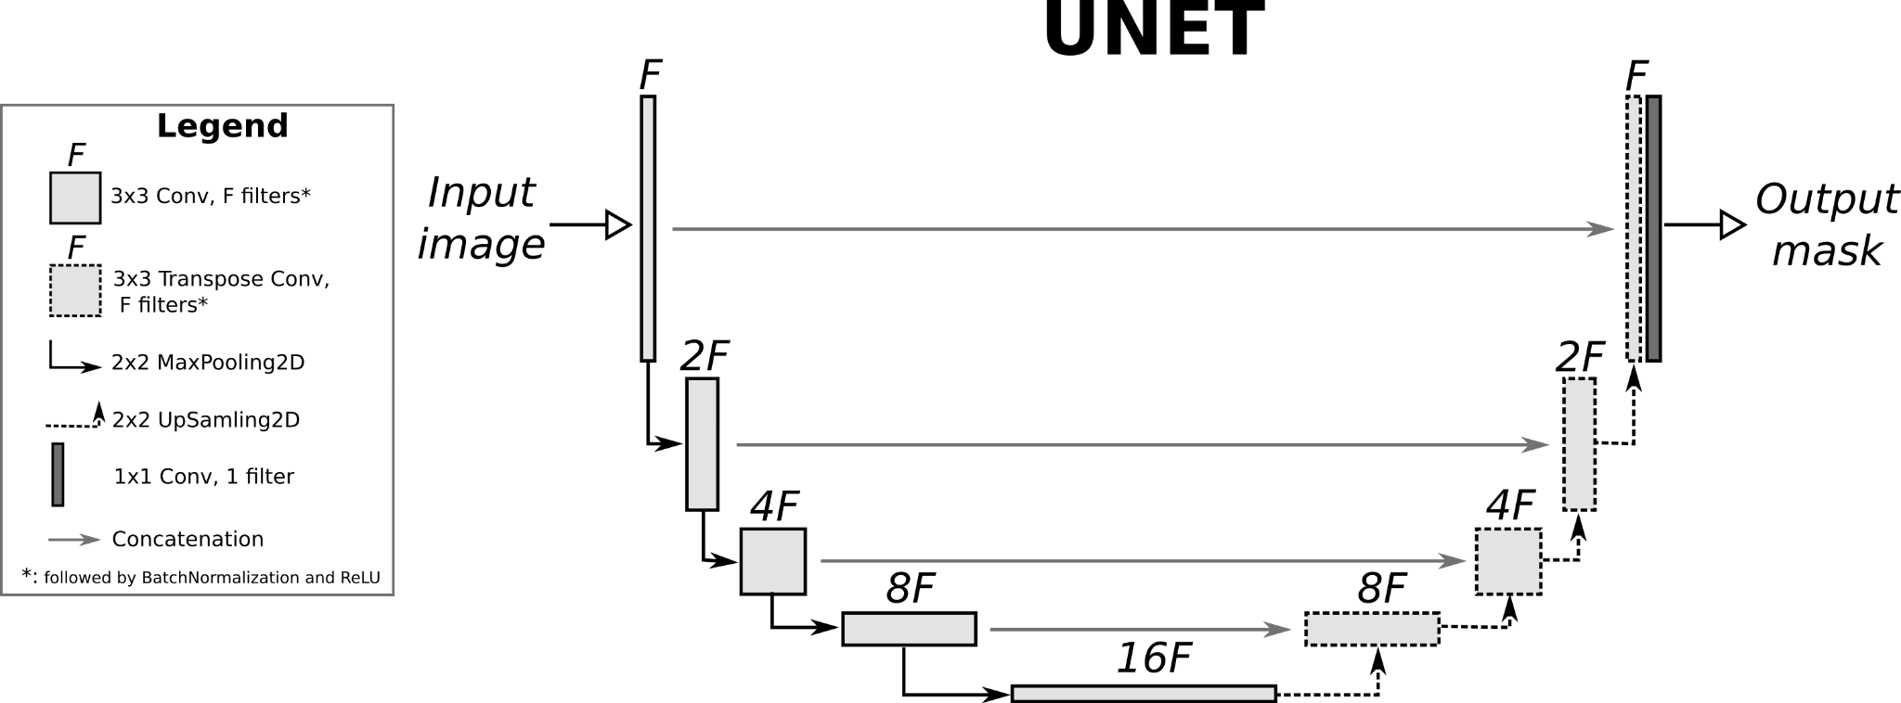
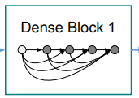
Our approach: overview
D
Encoder
Decoder
D
D
Ref Net: Unet
iRFFT
Conv blocks
Decoder
iFFT
FC blocks
|.|_1 -> 0
|.|_2 -> 0
|.|_2 -> 0

Slide 7
Our approach: main features
Fully connected layers to recover spectral from magnitude
Real FFT:
Low dimensional redundant sparse features representation: 64-256, x3 downsampled (256x8x8 featureses map)
Zero padding (0.25-0.5 oversampled)
Perceptual loss (lpips)
None GAN option
Rotation 180 invariant self supervision
Augmentation: random flipping, gamma correction , gaussian blur , free rotation, scaling
Large batch size in training(16-128)
Parametric Relu(PRelu) activation: prevent retrieval removing negative frequency

Slide 8
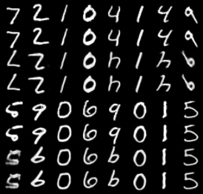
Evaluation: MNIST, Table
Model | MSE | MAE | SSIM
PRCGAN | 0.0168 | 0.0399 | 0.8449
CPR | 0.0123 | 0.0370 | 0.8756
Our method | 0.0103 | 0.0367 | 0.8849
Original
Autoenccded
Recon
Recon + RefUnet

Slide 9
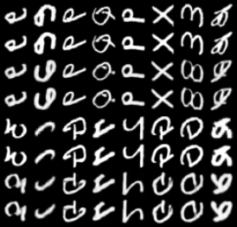
Evaluation: EMNIST, Table
Model | MSE | MAE | SSIM
PRCGAN | 0.02390 | 0.06010 | 0.80820
CPR | 0.01440 | 0.05010 | 0.87000
Our method | 0.01207 | 0.04527 | 0.87579
Original
Autoenccded
Recon
Recon + RefUnet

Slide 10
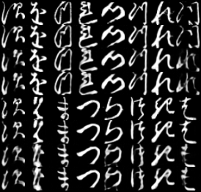
Evaluation: KMNIST, Table
Model | MSE | MAE | SSIM
PRCGAN | 0.0651 | 0.1166 | 0.5711
CPR | 0.0433 | 0.1034 | 0.6624
OUR METHOD #1 | 0.0425 | 0.1007 | 0.6459
Our method #2 | 0.0426 | 0.1006 | 0.6450
Original
Autoenccded
Recon
Recon + RefUnet

Slide 11
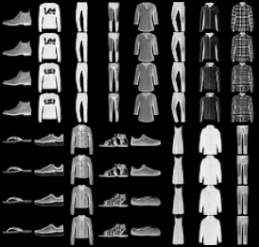
Evaluation: Fashion MNIST, Table
Model | MSE | MAE | SSIM
PRCGAN | 0.0151 | 0.0572 | 0.7749
CPR | 0.0113 | 0.0497 | 0.8092
Our method | 0.0082 | 0.0436 | 0.8344
Original
Autoenccded
Recon
Recon + RefUnet

Slide 12
Open tasks
Huge learning parameters in fully connected layers,64x64 limit for v100 GPU
Maybe: transform inspired blocks
Significant overfitting x10
Refinement U-net has a poor improvement
Sparse fully connected blocks, sparse and L0 regularization (L1 not good)
Pure texture reconstruction
Iterative(non one shot) via AdaIn

Slide 13
Next steps
Paper draft
Dev
Check padding concept again
AE dictionary border, pads convolution
AE dictionary: increase size of the future 8x8-> 16x16
Train FC dictionary decoder separately
Pruning of FC decoder
Real dataset:
Cryo-Electron Microscopy
Fast MRI
Crystallography

Slide 14
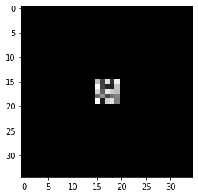
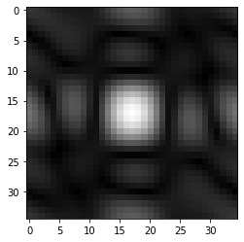
Conv filter 5x5 and its magnitude

Slide 15
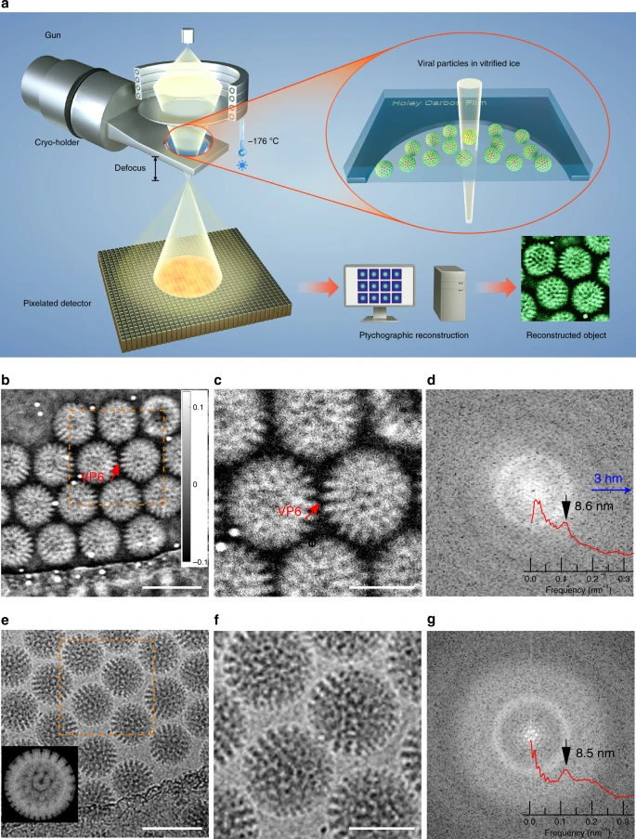
Cryo-Electron Microscopy
Overview:
lecture
A single-shot phase retrieval method for phase measuring deflectometry based on deep learning, Sep 2020, link
Segmentation-based Feature Extraction for Cryo-Electron Microscopy at Medium Resolution, 2021
Low-dose phase retrieval of biological specimens using cryo-electron ptychography. Nature 2020
QUANTITATIVE PHASE IMAGING OF SINGLE PARTICLES FROM A CRYOEM MICROGRAPH, May 2021,
SSR-PR: Single-shot Super-Resolution Phase Retrieval based two prior calibration tests
Classical
EJ Candes, Y. Eldar, T. Strohmer and V. Voroninski. Phase retrieval via matrix completion. SIAM J. on Imaging Sciences 6(1), 199 –225.
EJ Candès, X. Li and M. Soltanolkotabi. Phase retrieval via Wirtinger flow: theory and algorithms. IEEE Transactions on Information Theory 61(4), 1985–2007.
A. Singer, Y. Shkolnisky, Three-Dimensional Structure Determination from Common Lines in Cryo-EM by Eigenvectors and Semidefinite Programming, SIAM Journal on Imaging Sciences, 4 (2), pp. 543-572 (2011).
L. Wang, A. Singer, Z. Wen,''Orientation Determination from Cryo-EM images using Least Unsquared Deviations", SIAM Journal on Imaging Sciences, 6(4), pp. 2450-2483 (2013).

